Slide 1

Pedestrian Safety in Greater Wilshire
HACK FOR LA
Henry Kaplan & Derek Plemons
Hack For LA Data Science
Updated July 29, 2021

Slide 2
The Question
Will any of our datasets show us where we can make Greater Wilshire safer for pedestrians and cyclists?

Slide 3
Sources of Data
City of LA - Traffic Accidents by Date
for data on pedestrian and cyclist traffic collisions
https://data.lacity.org/Public-Safety/Traffic-Accidents-by-date/2mzm-av8t
Mapillary.com API
for data on road safety features
https://www.mapillary.com/developer/api-documentation
Mapillary collects street-level imagery of roads and programmatically extracts data about the road design and features.
Mapillary has given us access to their database and and Hack For LA members have built tools for working with mapillary data that we have built on.
Data collected by the City of LA on traffic accidents, extending back to 2010.
Includes the police “MO” code, classifying the type of accident.

Slide 4
Collisions with Pedestrians and Cyclists

Slide 5
Gathering city data
From the City database of traffic collisions going back to 2010, we pulled all incidents with the following police MO Codes: - 3003 — Veh vs Ped - 3008 — Veh vs Bike - 3016 — Bike vs Veh - 3501 — Ped Actions
Using the City’s shapefile for neighborhood council boundaries, we added neighborhood council information for each incident. Source: https://data.lacity.org/City-Infrastructure-Service-Requests/Neighborhood-Councils-Certified-/fu65-dz2f

Slide 6
Greater Wilshire in Context
Yearly collisions with pedestrians and cyclists in Greater Wilshire and neighboring Neighborhood Council districts
MAKE AND INSERT THIS GRAPHIC!!!

Slide 7
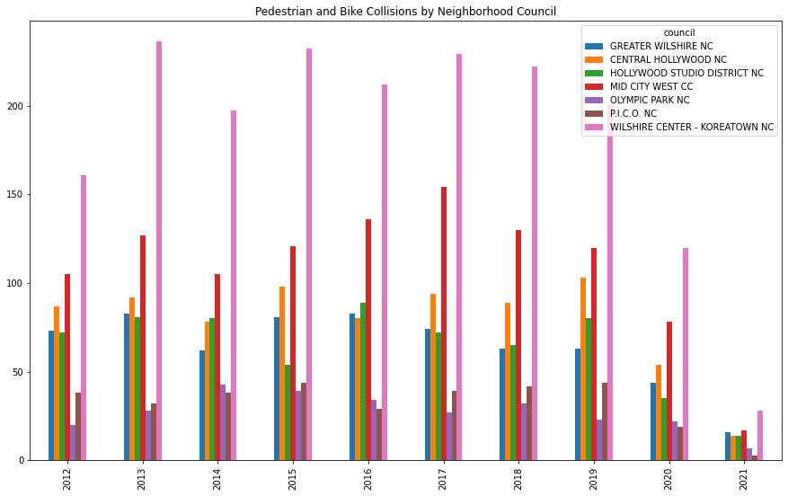
Greater Wilshire in Context
Yearly collisions with pedestrians and cyclists in Greater Wilshire
…and neighboring Neighborhood Council districts

Slide 8
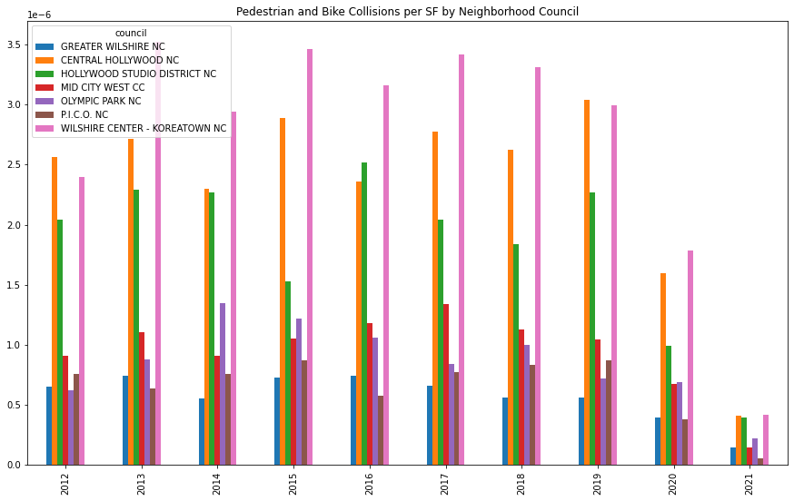
Greater Wilshire in Context
Yearly collisions with pedestrians and cyclists in Greater Wilshire
…and neighboring Neighborhood Council districts
...adjusted for council size

Slide 9
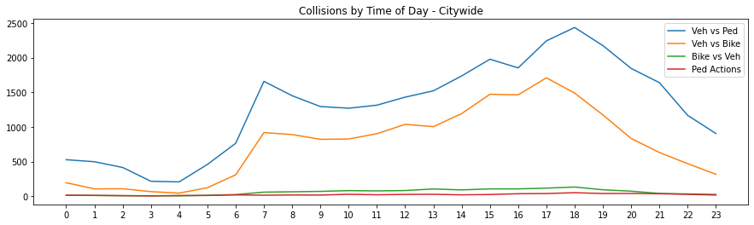
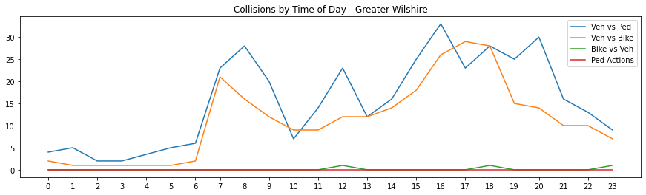
Incidents by Time of Day

Slide 10
Safety Features

Slide 11
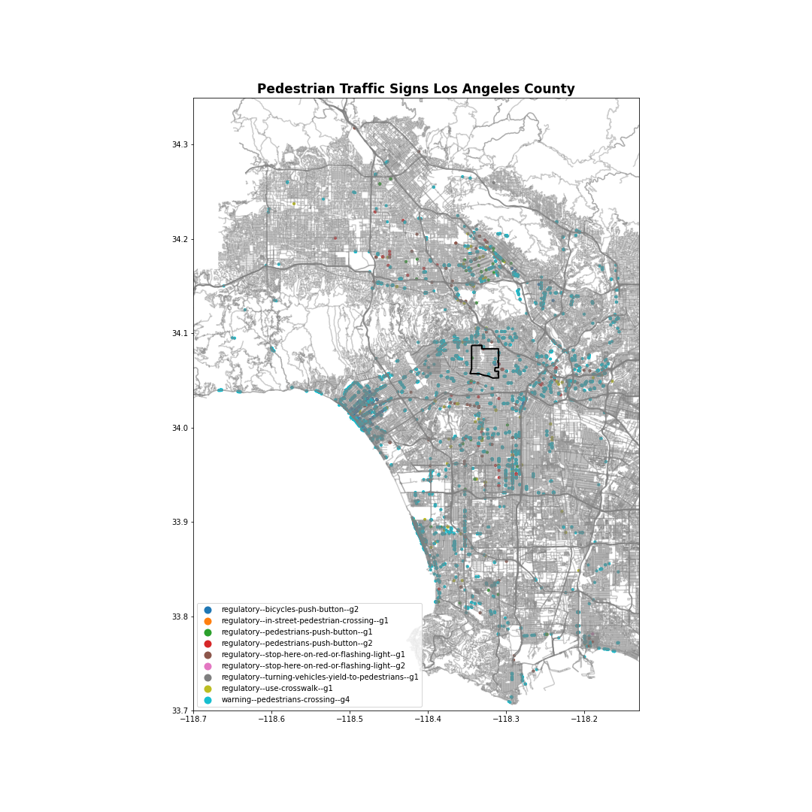
Our first attempt
We began by pulling all records from Mapillary of signs about pedestrians, crosswalks, flashing light warnings.
Mapillary signs categorized as:
4543 - warning--pedestrians-crossing--g4
119 - regulatory--bicycles-push-button--g2
108 - regulatory--stop-here-on-red-or-flashing-light--g1
105 - regulatory-use-crosswalk--g1
61 - regulatory--pedestrians-push-button--g1
49 - regulatory-pedestrians-push-button--g2
11 - regulatory--turning-vehicles-yield-to-pedestrians--g1
1 - regulatory--stop-her-on-red-or-flashing-light--g2
1 - regulatory--in-street-pedestrian-crossing--g1

Slide 12
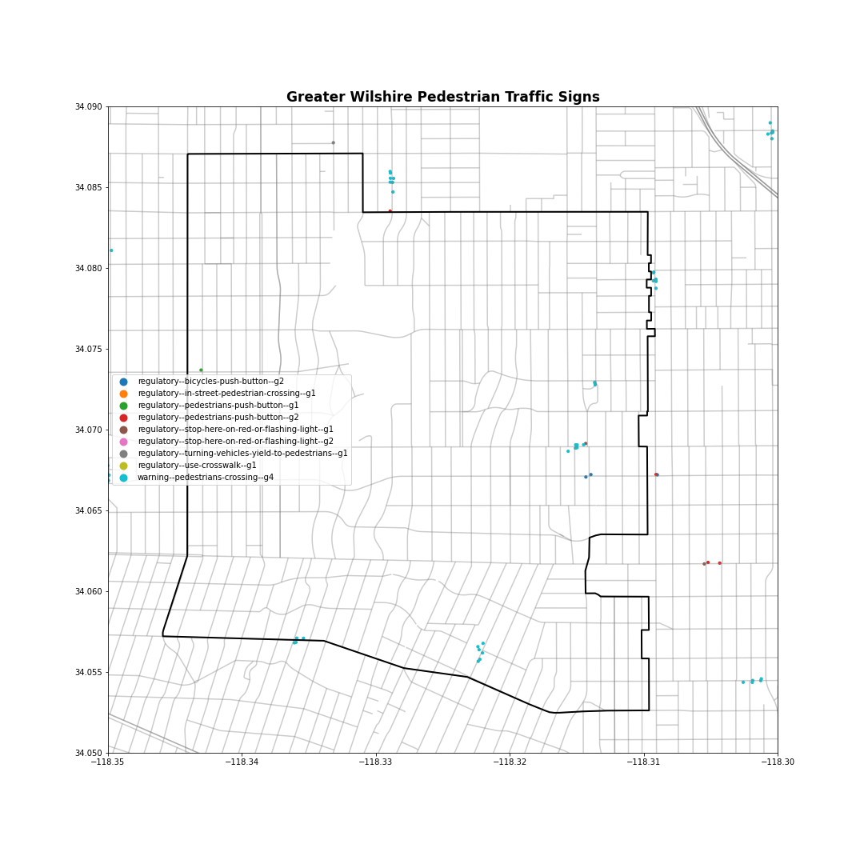
We found that Mapillary’s sign database was not a good proxy for pedestrian safety features.

Slide 13
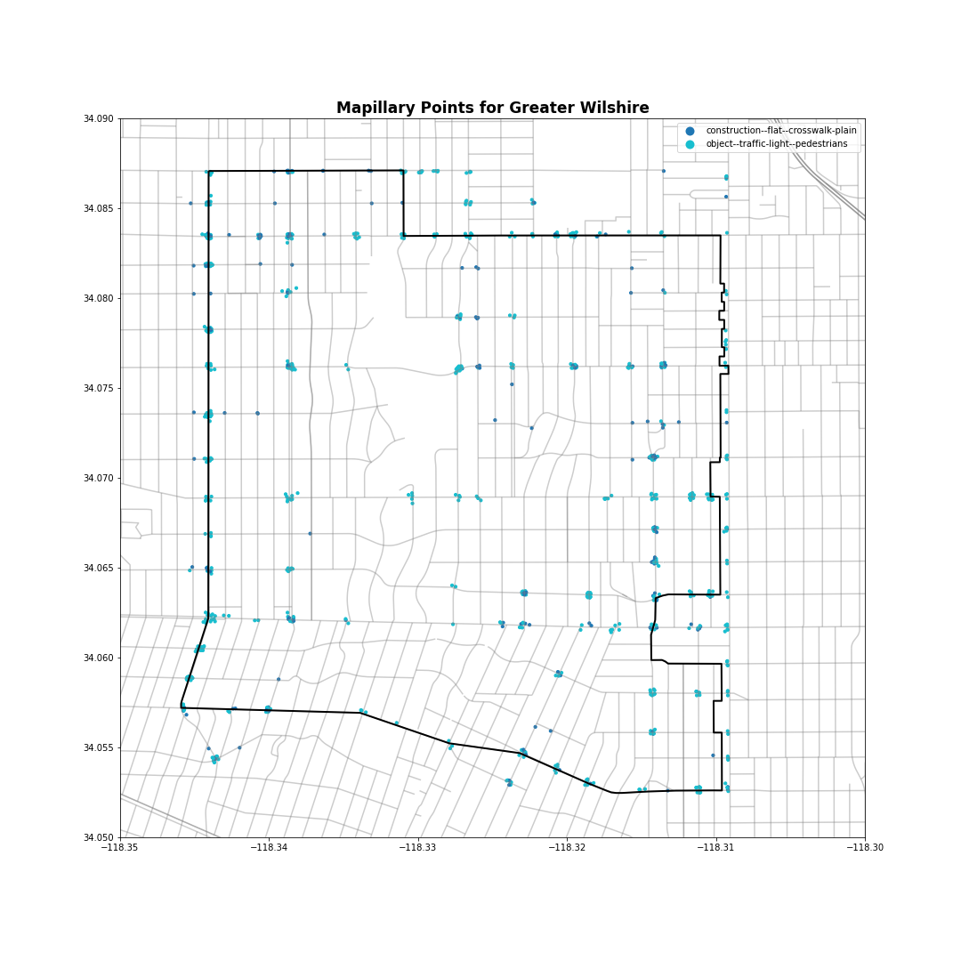
Mapping Crosswalks
Rather than mapping pedestrian warning signs, we next mapped crosswalks.
Using Mapillary’s separate “features” database, we looked at physical features catergorized as pedestrian lights or crosswalks.
Mapillary categories included:
object--traffic-light—pedestrians
marking--discrete--crosswalk-zebra
construction--flat--crosswalk-plain

Slide 14
Comparing Accident Locations to Crossing Locations

Slide 15
Overlaying Safety Features and Accidents
To look for places with more accidents and less safety features, we created a graphic with three overlays:
🟢 A green heat map of pedestrian crossing elements.
🔴 A red heat map of recorded pedestrian and cyclist collisions.
⃝ A cluster analysis of pedestrian and cyclist collisions, to sum up the total number of collisions roughly at or near each intersection.

Slide 16
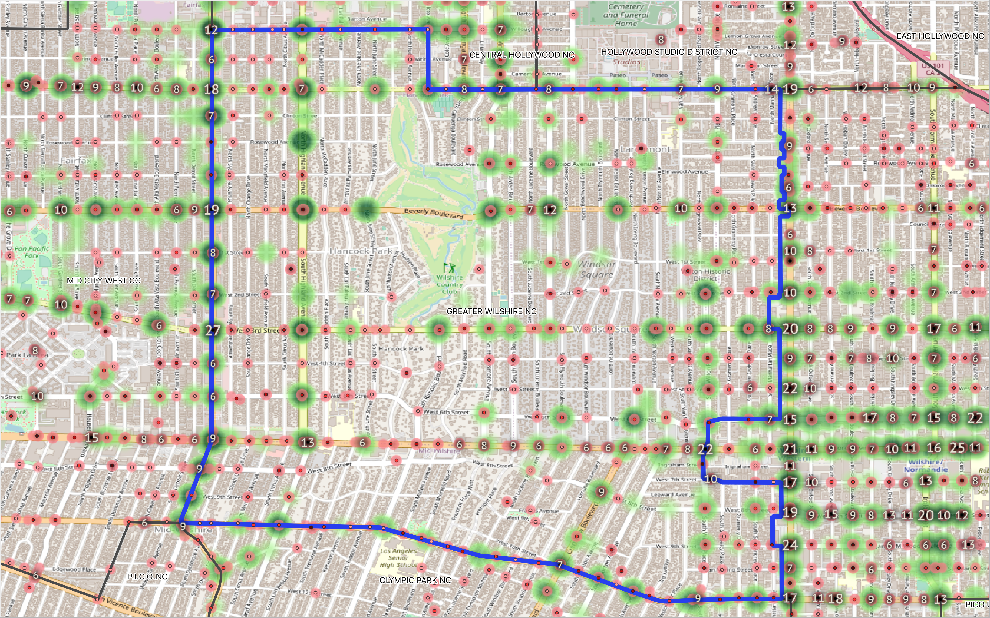

Slide 17
MAKE AND ADD MAP GRAPHIC WITH LOW-INCIDENT INTERSECTIONS FILTERED OUT!

Slide 18
Takeaways
Looking for places with few pedestrian crossings and a history of pedestrian and cyclist collisions, the stretch of Wilshire Blvd between Highland and Wilton stands out.
We don’t see a need for more lighting — any effect nightfall has is dwarfed by other larger effects, like the rise and fall of traffic.
Overall Greater Wilshire is not one of the hotspots of pedestrian and cyclist collisions in the City.

Slide 19
Thank you!
HACK FOR LA
Henry Kaplan & Derek Plemons
Hack For LA Data Science

